Slide 1

SC1015 Mini Project:
Hotel Reservation
Lab B137 | Team 2
Leong Justin | U2220207C
Roy Tan | U2221534G
Shaun Gan | U2221949C

Slide 2
Problem Definition
Motivation
Predict…
Identify…
Optimise…
Minimise…
…if someone will cancel their reservation
…key factors that contribute to the cancellation of reservations
…operations
…losses

Slide 3
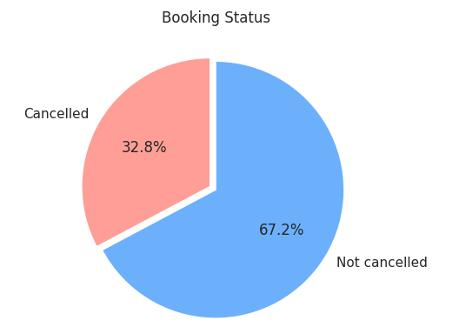
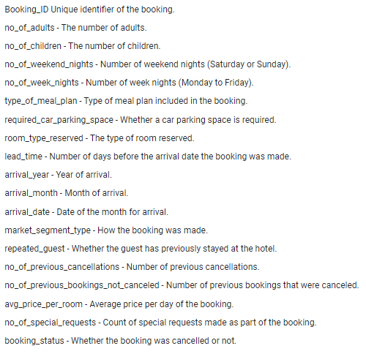
Exploratory Data Analysis
17

Slide 4

Data Preparation & Cleaning
Changing ‘booking_status’ to binary data
‘0’ for cancelled, ‘1’ for not cancelled
Changing variables to categorical data
Easier to work with
ID
Removing ‘Booking_ID’
Redundant variable

Slide 5
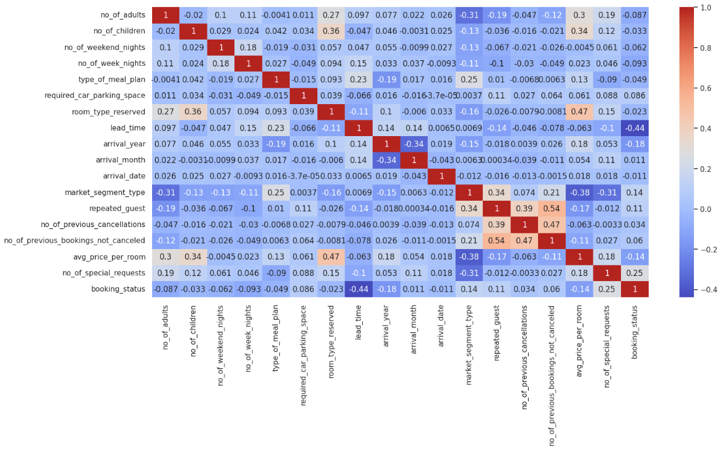
Exploratory Data Analysis (EDA)
Low correlation between variables ≠ Irrelevance
Other variables influencing the relationship!

Slide 6
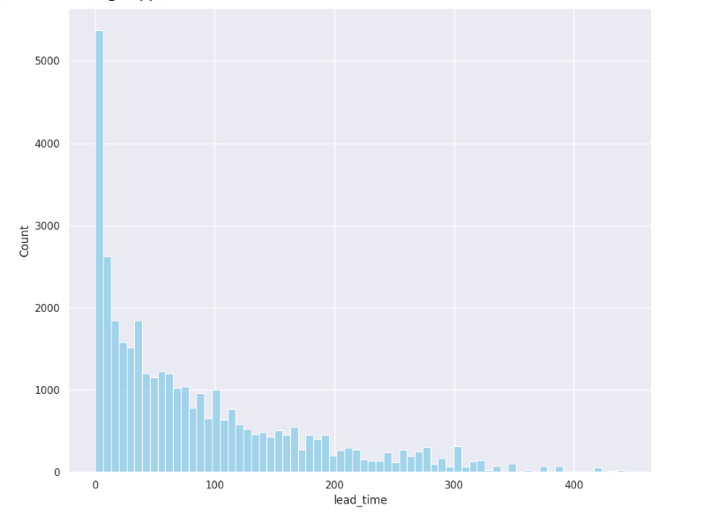
EDA: Lead Time

Slide 7
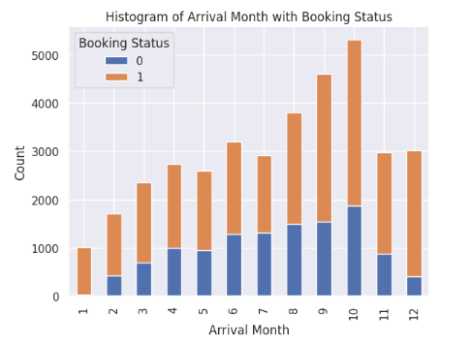
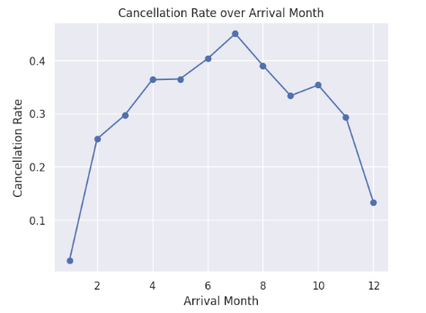

EDA: Arrival Month
Majority of bookings between July - October
Also has highest cancellation rates!
Identify factors influencing bookings
Strategies to reduce booking cancellations

Slide 8
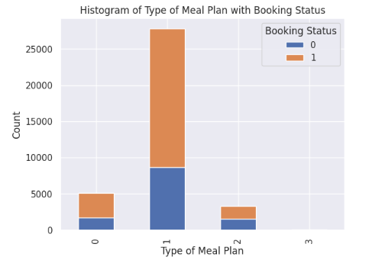
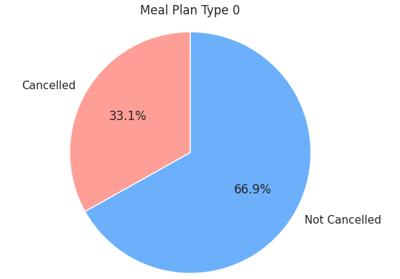
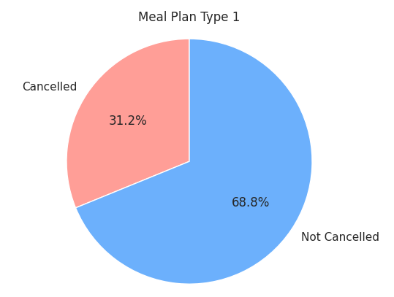
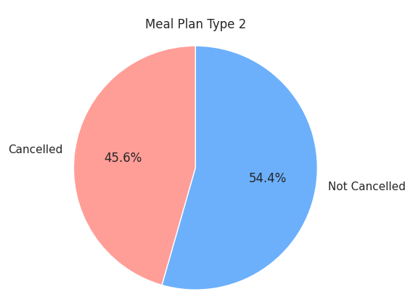
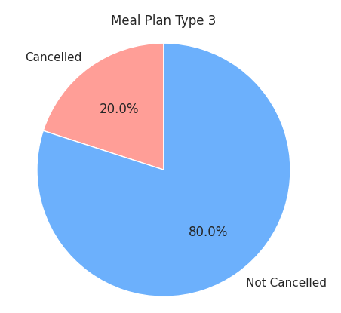
EDA: Meal Plan
‘0’ for cancelled, ‘1’ for not cancelled

Slide 9
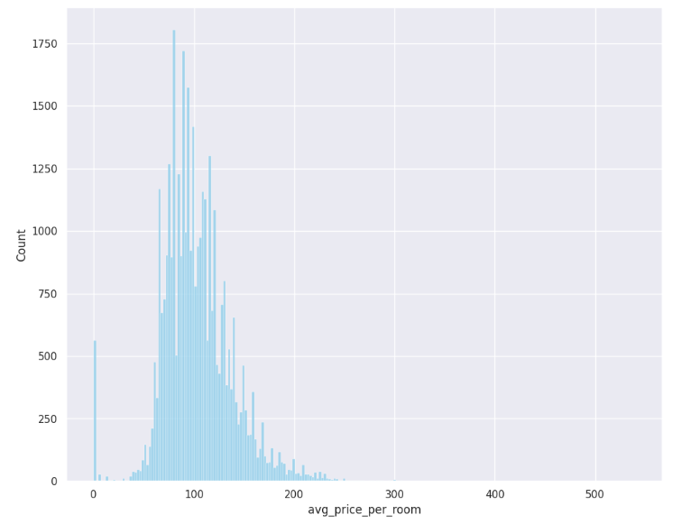
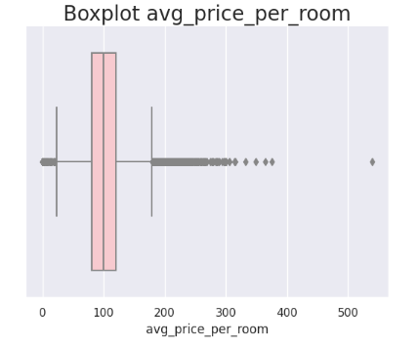
EDA: Average Price Per Room
Over 500 counts with average price ‘0’

Slide 10
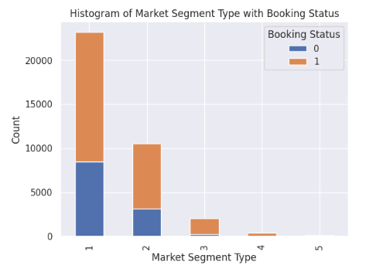
EDA: Market Segment Type
‘1’ – Online
‘2’ – Offline
‘3’ – Corporate
‘4’ – Complementary
‘5’ – Aviation
‘0’ for cancelled, ‘1’ for not cancelled

Slide 11

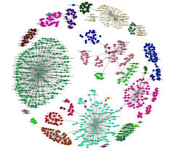
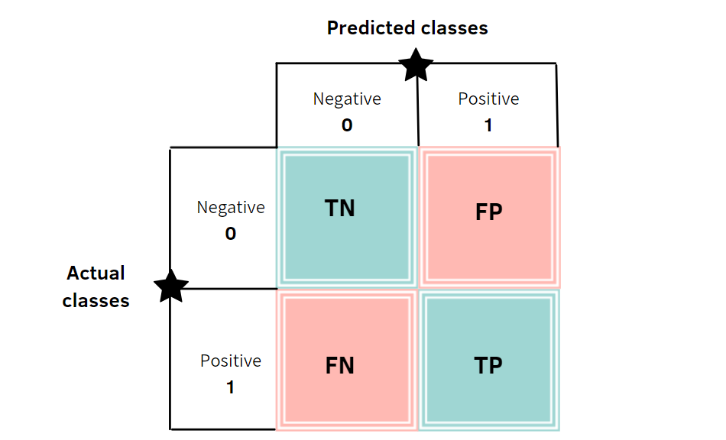
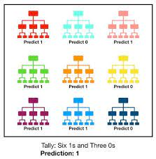
Machine Learning (ML) Techniques
Multi-Variate Linear Regression
Logistic Regression
K-Nearest Neighbours
ML Techniques Used
Confusion Matrix & Decision Tree
Random Forest

Slide 12
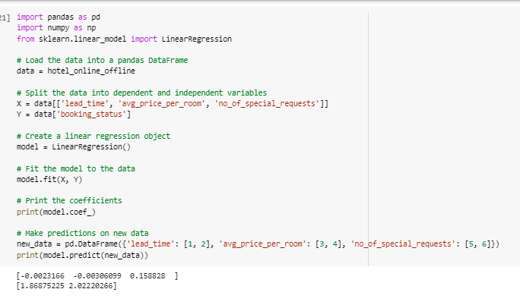
Multi-Variate Linear Regression
Determining if a combination of variables have a greater correlation with booking status
Predicting the booking status of new data
HOWEVER, ‘booking_status’ is a binary variable!
NOT A GOOD FIT

Slide 13
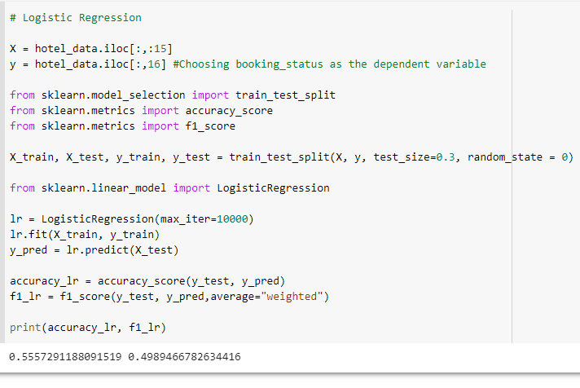
Logistic Regression
Handles datasets with outliers better than multivariate linear regression
Used for classification problems where outcome variable is categorical
Models relationship between the predictors and the probability of outcome, instead of outcome itself
Logistic Regression
55%

Slide 14
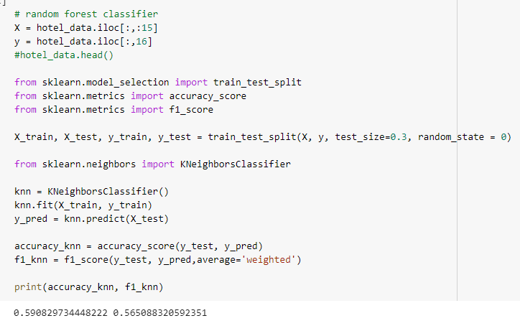
K-Nearest Neighbour (KNN)
KNN > Logistic Regression
Non-parametric algorithm that does not assume any particular form of the decision boundary between classes
More effective in high-dimensional spaces
KNN
59%

Slide 15
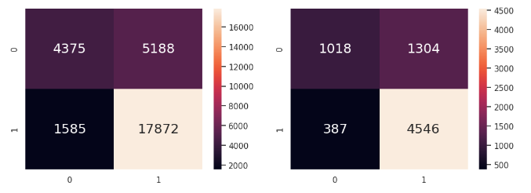

Confusion Matrix & Decision Tree
Well suited for binary classification problems
HOWEVER, single variable predictor resulted in lower accuracy
Confusion Matrix & Decision Tree
76%

Slide 16
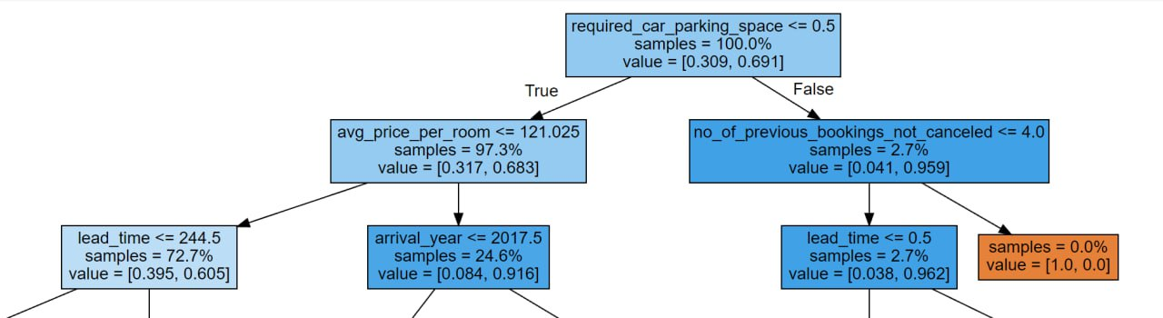
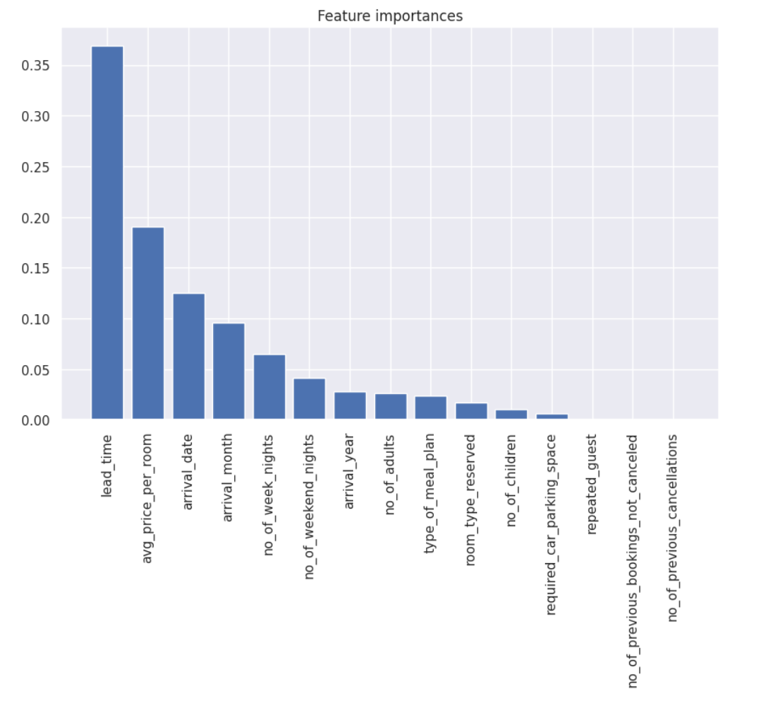
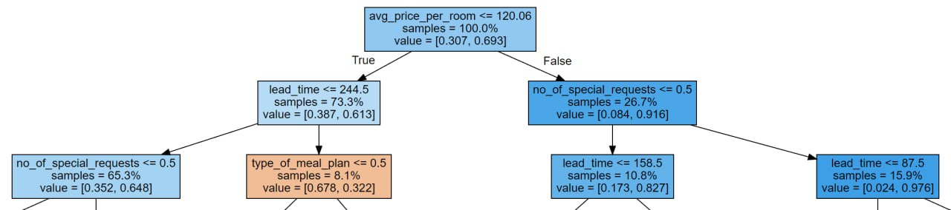
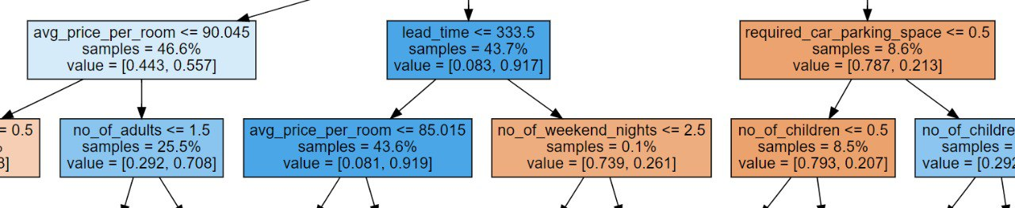
Random Forest
Reduces overfitting, handles
high-dimensional data
robust to noise and outliers
produces more accurate predictions, and provides better feature importance estimation!
lead_time
avg_price_per_room
arrival_date
arrival_month
Random Forest
83%

Slide 17
Accuracy Scores
Logistic Regression
55%
KNN
59%
Confusion Matrix & Decision Tree
76%
Random Forest
83%

Slide 18

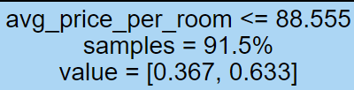
Average Price Per Room
When the price of room is <=76.54, the cancellation rate is at 0.144.
However, when the price of room is <=88.555, the cancellation rate increases significantly to 0.367.
This is reflected in real life cases, where thrifty customers would want to get the best deals possible and would cancel their bookings if they find a cheaper alternative.

Slide 19
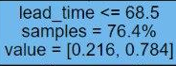


Lead Time
When lead_time decreases from 244.5 ->68.5 days, cancellation rate decreases significantly from 39% -> 21.6%
However, when lead_time increases from 244.5->333.5 days, the cancellation rate decreases as well
While the results seems contradicting, we can see this results in real life as:
People who book closer to their arrival date are less likely to cancel, as it would be hard to find another hotel with little time
People who book very far from their date are unlikely to cancel, as they may have made firm travel plans and committed to their trip

Slide 20
Conclusion
Overall, a potential solution to assist hotels in maximizing their operations and reducing losses stemming from cancelled reservations is to provide reduced prices for rooms during the sweet spot period with the highest cancellation rate when customers make reservations.

Slide 21
Thank You!

Slide 22
References
https://www.kaggle.com/datasets/ahsan81/hotel-reservations-classification-dataset
https://www.w3schools.com/python/python_ml_multiple_regression.asp
https://towardsdatascience.com/building-a-logistic-regression-in-python-step-by-step-becd4d56c9c8
https://realpython.com/knn-python/
https://towardsdatascience.com/random-forest-in-python-24d0893d51c0

